Slide 1

A Church experience for all learning types
A place to dance, draw, wiggle and rest in God
“Let the little children come unto me. ” Lk 18:16

Slide 2
The Principles supporting
Rhythms of Grace
  *Inclusion of all
  *Tailored to characteristics/needs of the
  population
  *Informal ~ Experiential ~ Flexible
  *Theologically and Liturgically sound

Slide 3
Rhythms of Grace is…..
WORSHIP
FORMATION
A GATHERING OF THE BODY OF CHRIST
PART OF THE EMERGENT CHURCH MOVEMENT
FAMILY CENTERED
WITH THERAPEUTIC VALUE
AN EXPRESSION OF GOD’S LOVE

Slide 4
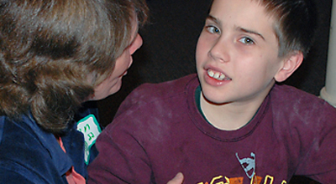
Our Beginnings

Slide 5
What is Autism Spectrum Disorder?
A neurological, biological, developmental disorder
Recent studies show that 1 in 88 children are diagnosed on the spectrum
1 in 54 boys •1 in 252 girls
Other Developmental Disabilities
About 1 in 6 children in the U.S. had a developmental disability in 2006-2008, ranging from mild disabilities such as speech and language impairments to serious developmental disabilities, such as intellectual disabilities, cerebral palsy, and autism.
http://www.cdc.gov/ncbddd/autism/data.html

Slide 7
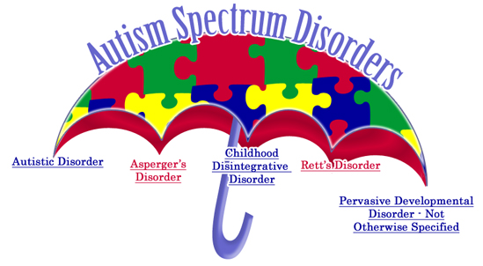

Slide 8
Autism Affects Four Areas
Communication
Social Skills
Behavior
Learning

Slide 9
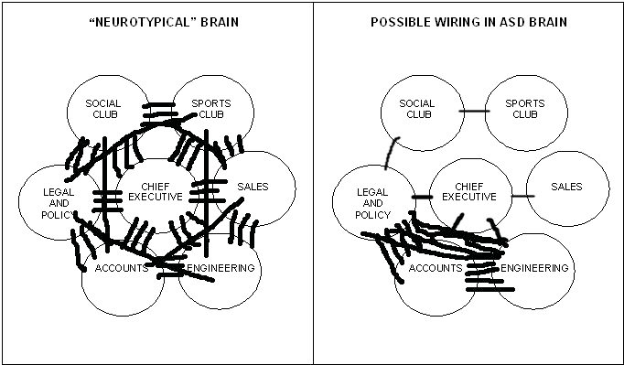
http://www.oxford.anglican.org/social-justice/disability/welcoming-those-with-autism-and-asperger-syndrome-in-our-churches-and-communities.html
Notes:
The world-famous Dr Temple Grandin, who is autistic, explained that an autistic mind is like an office building, in which the accounts and engineering department got all the phone lines, and the people in sales and marketing didn’t really get any at all. In simple terms, it could be described like this: graphic by Diocese of Oxford, England (social responsibility)

Slide 10
Characteristics
Autism appears on a Spectrum
Difficulty in communication
Poor eye contact
Delay in gross motor skills
Delay in fine motor skills
Fixations
Need for routine
Echolalia (repeating
information over/over)
Sensitivity to touch/
tactile items
• Inappropriate use of
objects
• Transition problems
Flapping
Oral receptive language difficulty
Inability to “read” others body language
Inability to “read” other’s emotions
Sensitivity to light, sound, or
smell

Slide 11
Other possible sensitivities/challenges
Mobility issues/accessibility
Sight impairment
Hearing impairment
Possibility for environment-triggered seizure
A danger of flight/ impulsivity

Slide 12

So what might happen when a person on the Autism Spectrum tries to attend a “Traditional Worship”?

Slide 13

But First…..
  What does your website
  say about you?
  Over 80% of church visitors
  look at the website first.
  Does your church website
  extend a clear welcome to
  families with special needs?
  Does your website offer an opportunity for someone from the church to meet with families to preview a worship service or facility?

Slide 14
and consider….
The Physical Plant-
Transitions-to spaces…ramps…access to safe space
  Acoustics…sound system…organ…singing
  Lighting…brightness…flickering
  Chairs…hardwood…padding…design in fabric…texture
  Smells…incense…flowers

Slide 15

There’s a lot to think about
Notes:
----- Meeting Notes (2/5/13 08:29) -----
LET'S TAKE A SHORT LOOK AT OUR TRADITIONAL WORSHIP THROUGH THE EYES OF A PERSON ON THE AUTISM SPECTRUM…..KEEP IN MIND THE CHARACTERISTICS WE HAVE JUST REVIEWED...

Slide 16
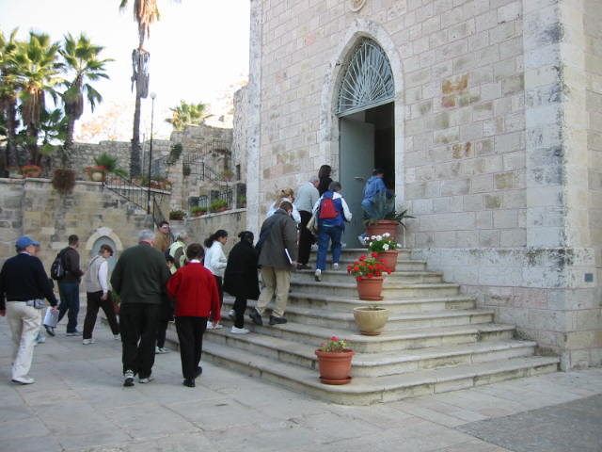
Gathering
Notes:
----- Meeting Notes (2/5/13 08:29) -----
DO YOU SEE ANY OBSTACILES IN THIS GATHERING PICTURE?

Slide 17
Notes:
Handed a worship bulletin with one or more pieces of paper…possibly unable to read or understand the order of service…may have abbreviations that not understandable to others
*Where to sit back/front/side *Hard wood pews/chairs/padded chairs with material (pattern on material) *If someone speaks there is the social aspect…how to respond?
----- Meeting Notes (2/5/13 08:29) -----
NOW WHEN AND IF YOU CAN ACTUALLY GET TO THE DOOR HERE IS WHAT WE MEET.

Slide 18
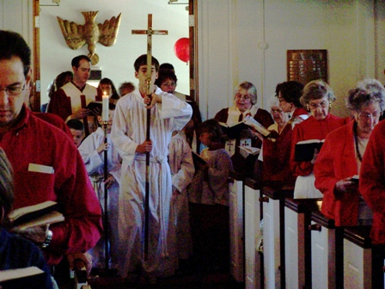
Processional
Notes:
* What do I do when the music starts? *Do I stand/sit/sing…Where do I find music? *What book…number…do I need to sing…
*Possible sensitivity to sound? *Possible sensitivity to smell (use incense)

Slide 19
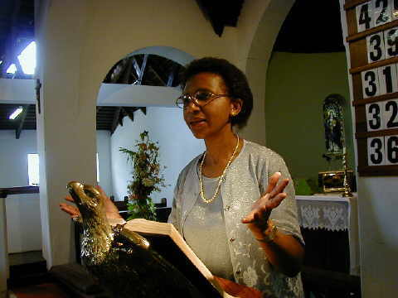
Liturgy of
the Word
Notes:
*All readings are for auditory learners * Listeners must be quite and contained in a confined space
*Readings are metaphoric ASD persons take everything literally *Language in readings is not always modern
*Readings are snippets of whole stories *Prayers of People, Confession, Creed~~~All Corporate Prayers….A person with ASD has little understanding of “The body”, “The whole” very individualized and literal-Do “I believe” everything “we” are saying?

Slide 20
Notes:
•Sign of the Peace
*ASD person must now deal with social interaction-eye contact and the physical action of shaking hands plus the verbal exchange…touching!... “What do I say”
•Offertory *More music…..plate passed to me? It has money in it? Must touch plate…It has money in it…is it for me? Do I have to find some money and put it in the plate? For what reason?

Slide 21
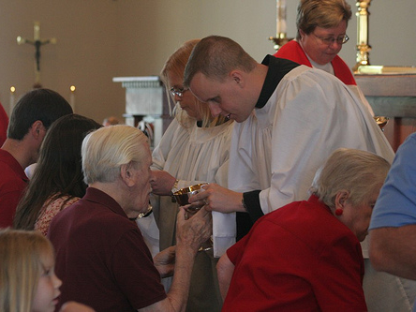
Holy Communion
Notes:
“I AM TOTALLY EXHAUSTED BY NOW”
•Eucharistic Prayer * Do I stand-sit-kneel (people are doing all 3 which is correct?) * It is all verbal…with possible music * I take things literally…. “this is my body” “this is my blood” *All visual clues are metaphors
Movement to Altar to Receive!!!! *Where are people going….what are they doing?
*Again..do I stand, kneel….dipping something… hands out….what am I drinking….I’m touching something everyone else is….if I don’t want this…I see the priest touching foreheads…do I want to be touched?
*Back to pew….Which is it? Sensitivity to taste-touch-food-people close around you-music……

Slide 22
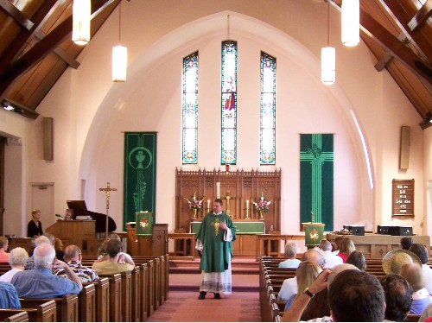
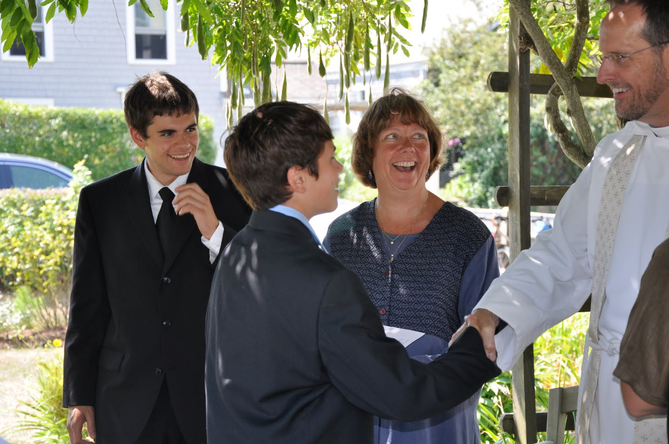
Blessing….
and
Dismissal
Notes:
Blessing/Dismissal
All corporate prayers, verbal, with music
•Departing
*What do I do-some are sitting and listening to the music…some are leaving the way I came in….some are talking to each other….some are leaving in a different direction (coffee hour)-
*To get to the door where I came in to leave there are people lined up talking and shaking hands with the Priest! Verbal conversation and touching!

Slide 23
Again, There’s a lot to think about
Notes:
Audrey and I felt, There’s got to be a better way to address the needs of our families with children on the spectrum. So we already knew there were many different forms of “worship” created because someone wanted to try something new and found that others also had a desire to worship this way. So we took our barebones outline of a worship experience (as you set up here on the clothes line) and tried to look for a way to combine it with the characteristics of the Austism Spectrum.

Slide 24
Processional
Gathering
Liturgy of the Word
Storytelling
Reflection on the word/Sermon
Response
Activities
Blessing…Dismissal…Go in Peace
Worship
Offertory
Regathering
Holy Communion
Notes:
Here is what we designed. The elements of a traditional worship but addressing the needs of families with children on the Autism Spectrum and….we found any neurological or developmental needs.

Slide 25
Pentecost Breath
Preparing Gifts~Epiphany
Gathering (15 mins)
As participants arrive, all work at a common, open ended
gathering activity
This Activity~
1. Gives children a chance to become familiar with the space
and faces.
2. Allows parents and caregivers to greet each other.
3. Introduces the theme of the day.
4. Allows a gracious “start” time to the program.

Slide 26
“Gathering-Placing stars in the sky
Lenten “Gathering”
Bible Stories
with quiet music

Slide 27
The Ten
Commandments
The Story Telling (10 mins)
Storytelling is done simply, using…
Pictures
Story Cards
Dramatic Interpretation
Hands-On Materials
Felt Board
Oral Refrains
The Presentation of Jesus

Slide 28
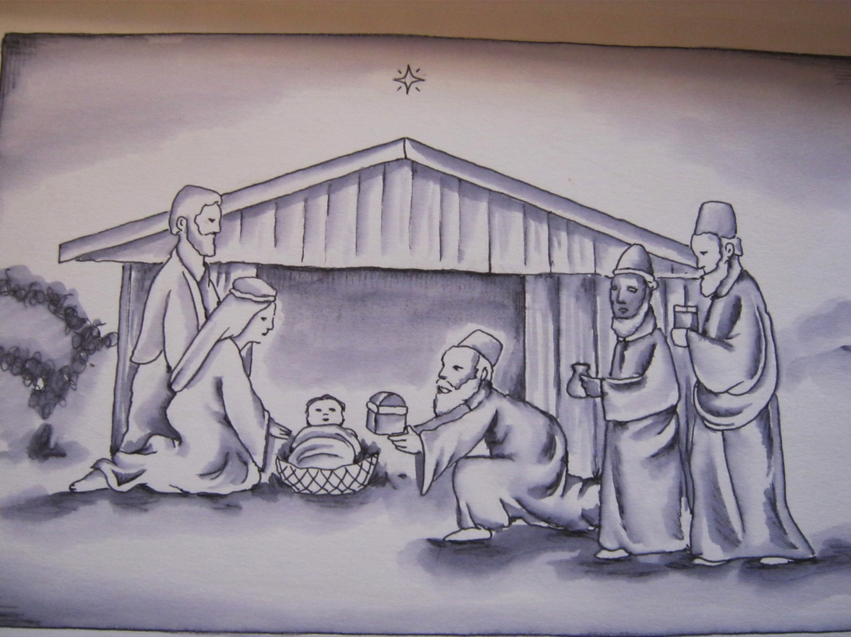
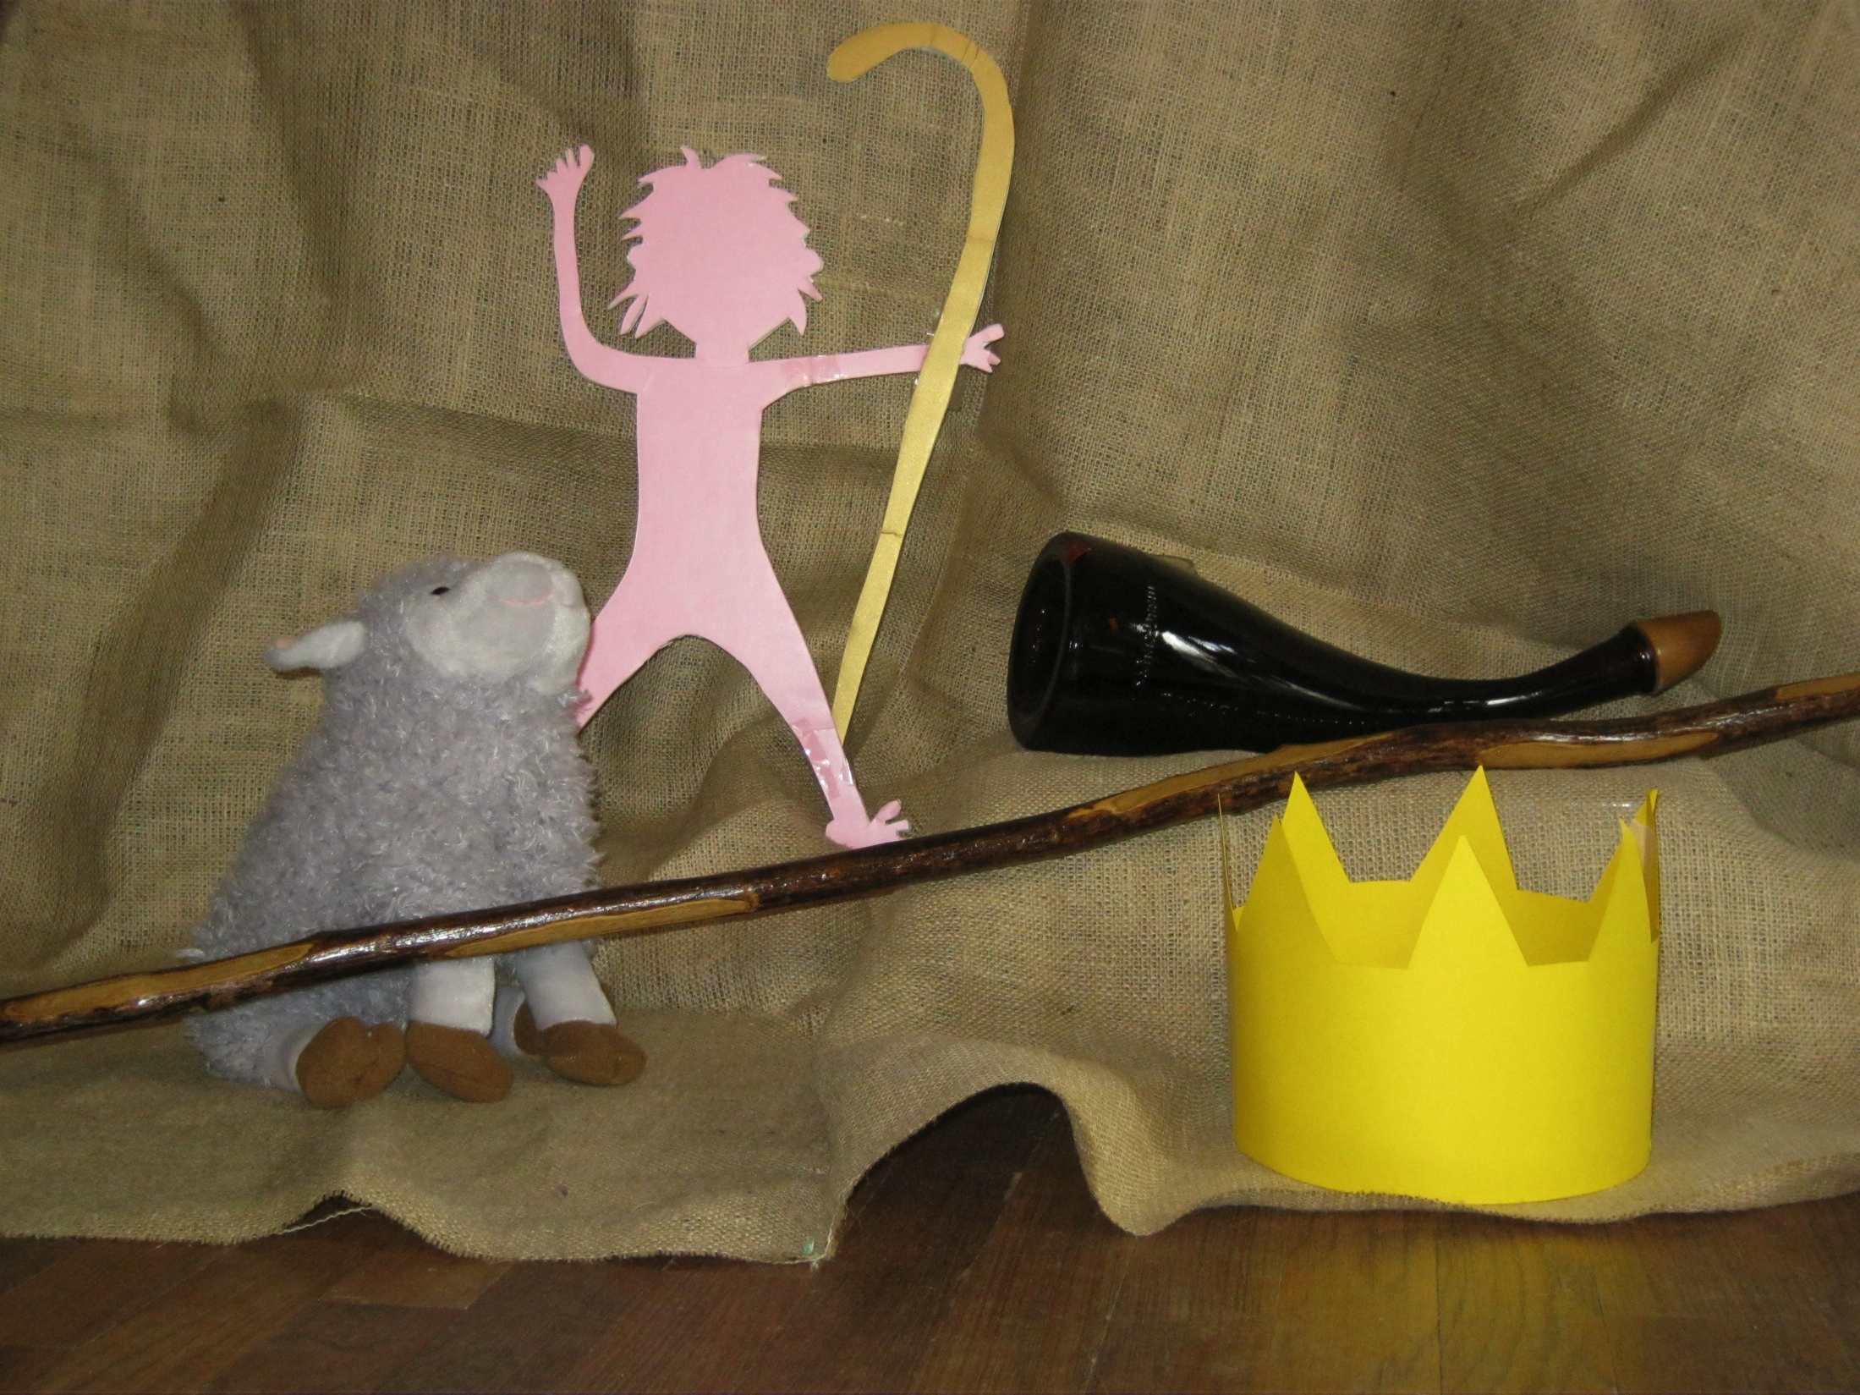
Epiphany Story Card
Epiphany-The whole story
The Calling of David Story Pieces
Notes:
Story card…..objects unwrapped by individuals…..Action story

Slide 29
Making Advent
Wreaths
Finding Lost Coins
Response Activities (20-30 mins)
At least three different “learning center” activities accompany each story to respond to and engage the Holy Scripture.
These activities focus on:
▪Gross Motor skills ▪Fine Motor Skills
▪Receptive Language skills
▪Kinesthetic Awareness
▪Oral Communication ▪Tactile Sensitivity
Notes:
Gross motor skills: trampoline, beating a drum, shaking a maraca, rolling/bouncing ball, parachute, following a path or playing hopscotch. Closely monitor the level of excitement or energy for the skill and help the children return to a state of calm.
Fine Motor Skills: Coloring, stringing beads, sorting small objects, gluing objects, painting. Use of hand over hand instructions is helpful in some of these activities as a way to help children begin to master the specific skill.
Receptive Language skills or Oral Communication: naming objects, asking for things, responding to questions, pointing to objects as they are named, following oral directions, working together and addressing others. Modeling good communication, having high expectations, setting clear boundaries, provide meaningful reinforcement and help build skills.
Kinesthetic Awareness: shaking maraca, beating drums tossing bean bags, walking a labyrinth, walking on the balance beam, negotiating a maze. Every part of every session presents an opportunity to engage this sense and foster an awareness of the body in space.
Tactile Sensitivity: searching for objects in buckets of dry rice, birdseed, husks, shredded wheat, free play in water or sand table, planting in soil, making bricks of mud, finger painting, etc. Be sure to communicate with parents about the tactile defensiveness needs of their child before proceeding with these kinds of activities.

Slide 30
Wind matching
Jesus the Carpenter
hammering nails
Tossing stars
Lost
Coins

Slide 31
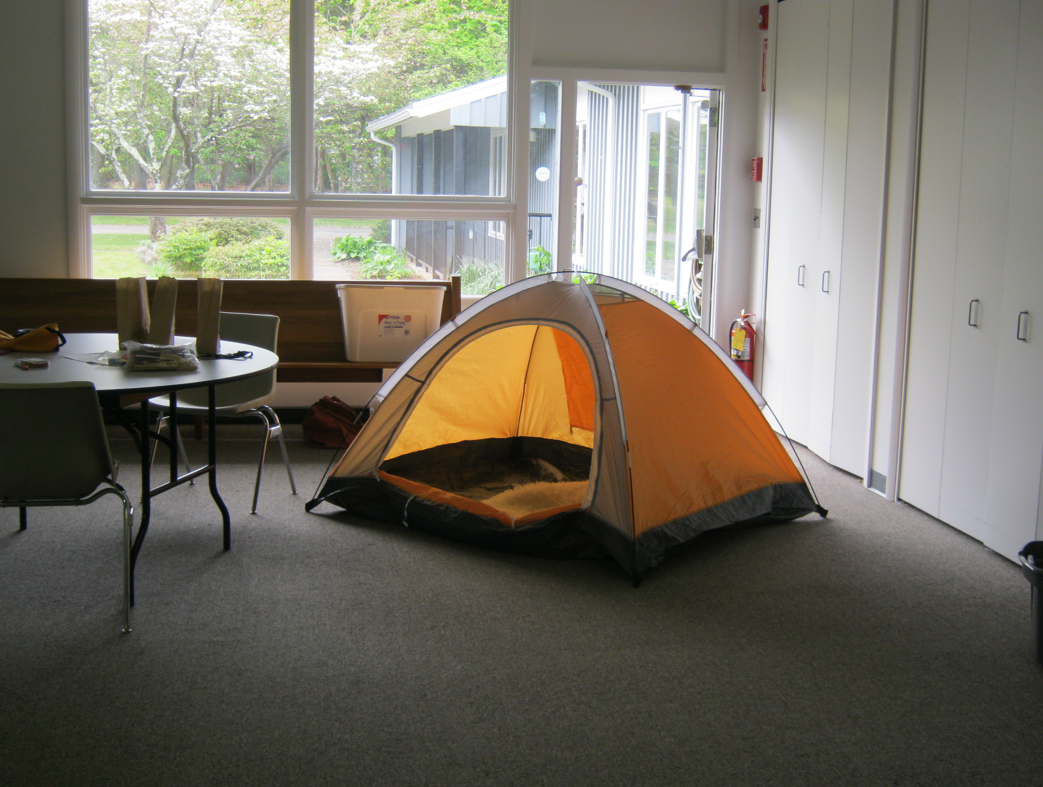
“Safe Space”
A place with cushions, chair or rug/mat allows children to watch from a distance or to take some time out from the activity.

Slide 32
Activities are also adapted to the abilities of the individuals participating. Additional activities may be necessary for teens or adults.
Notes:
1-Be Appealing 2-Mind you own business 3-Let sleeping dragons(or any other living thing) lie. 4-Take only your share. (take only what is yours) 5-Don’t make a mountain out of a mole hill (Don’t make a big deal out things that don’t matter) 6-Take no for an answer if the challenge is not accepted. 7-Don’t get mad at people for being slightly abnormal 8-Deal with certain things you many not like 9- Be responsible. 10-Respect other people’s opinions.

Slide 33
Rhythms
at Site 1
Re-Gathering (10 mins)
The community reassembles after the activity period with a group game or a song.
A game allows for the group to interact as a large body.
A song helps to prepare for Eucharist.
At Rhythms I, the table is set with a procession of elements. At Rhythms II, a procession with cross leads to the nave.
Notes:
This again depends on your site or your congregation. At our first site I used Jesu, Jesu to signal that it was time to re-gather and create our altar space. If a game was appropriate it would be done while the celebrant was creating the altar and preparing. Examples: Jesus Says, version of Simon Says…..

Slide 34
Setting the Table

Slide 35
Most formal part of service…..but conducted on floor in circle
Altar: wooden crate upside down
Fair Linen: burlap, colorful cloth
Chalice, paten, purificator
Elements- rice crackers, apple juice.

Slide 36
Holy Eucharist (15 mins)
A simple prayer is used to consecrate the elements.
Some standard liturgical features are included:
The Sursum Corda
The Sanctus
The Lord’s Prayer
The Fraction Anthem
Apple juice and rice crackers become the body and blood of Christ
The community is nurtured and nourished
Peace prevails

Slide 37
Dismissal (5 mins)
The post communion prayer is sung. “Jesus Loves Me” (with hand motions)
The Blessing is bestowed……..
Go in Peace to Love
and
Serve the Lord

